Slide 1
Learning Aim D
Factors influencing management, motivation and
performance of the workforce

Slide 2
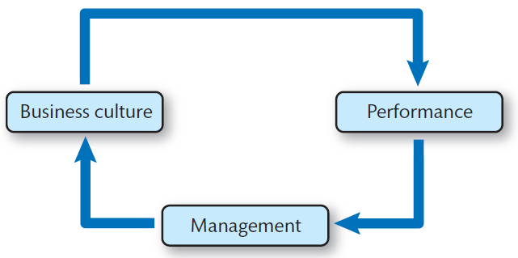
Motivation in the workplace
A workforce comprised of motivated employees is much more likely to result in a successful business. Motivated employees are more likely to respond to change and buy into the business ethos.
Motivation is generated by a positive business culture with an effective and efficient workforce.

Slide 3
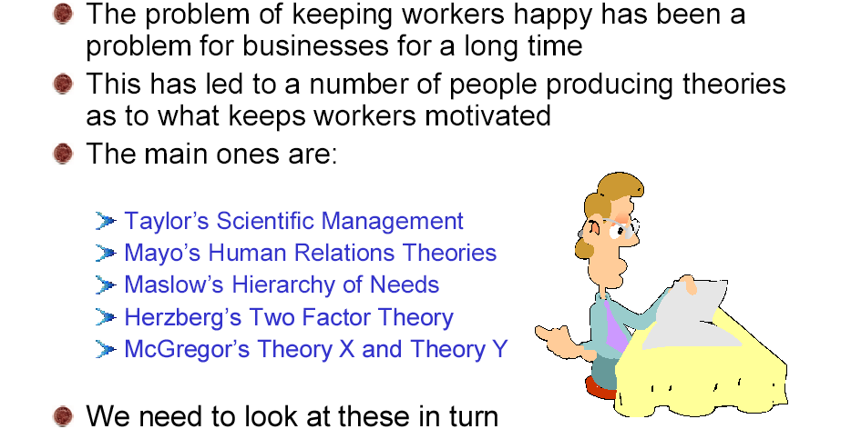
Motivation in Theory

Slide 4
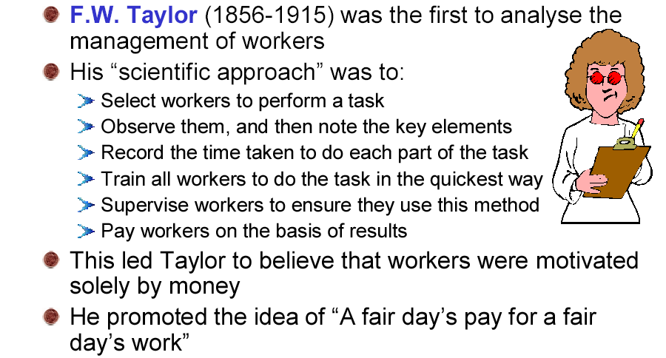
Taylor’s Scientific Theory

Slide 5
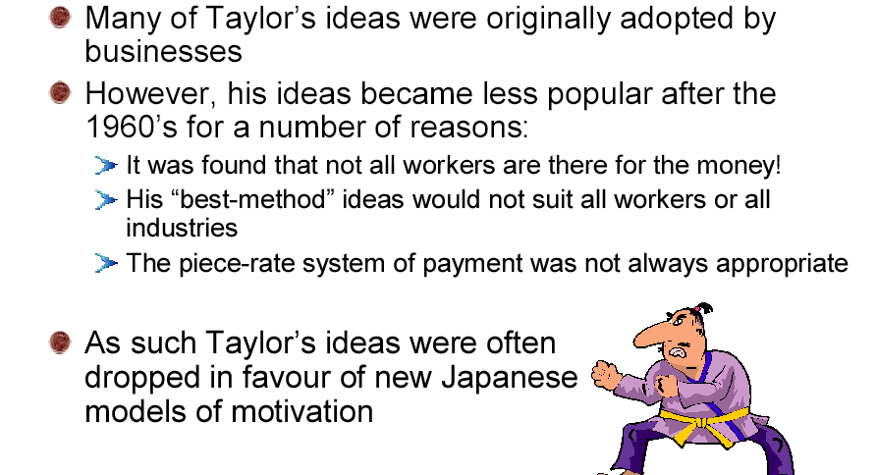
Are Taylor’s Ideas Valid?

Slide 6
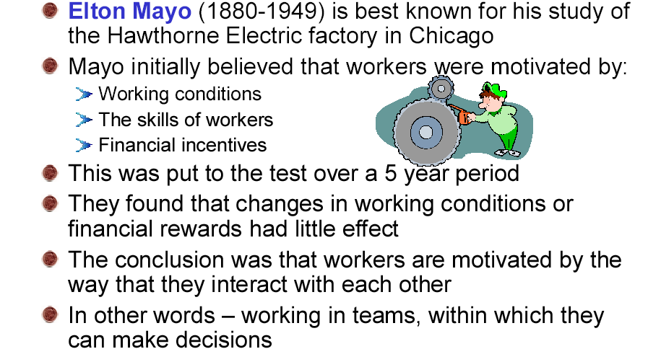
Mayo’s Human Relation School

Slide 7
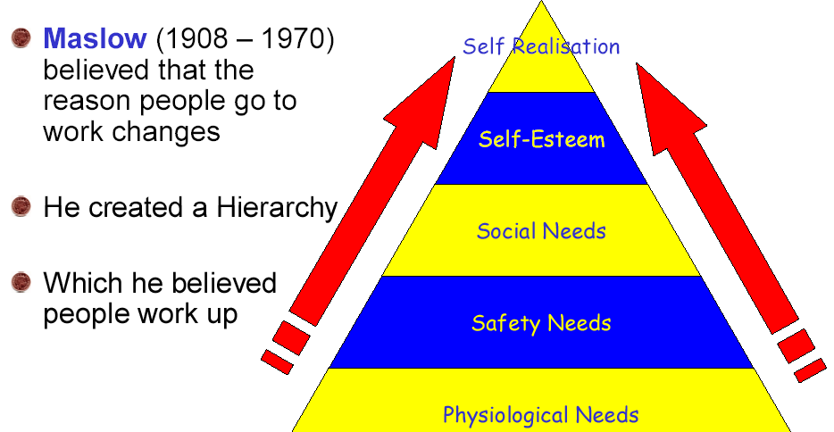
Maslow’s Hierarchy of Needs

Slide 8
Application of Maslow within the workplace
Maslow’s level What the organisation could do
Physiological Competitive salary
Safety Safe working condition
Social Work social events
Esteem Feedback via appraisal, generally praising staff
Self actualisation Allocating more challenging and stimulating responsibilities

Slide 9
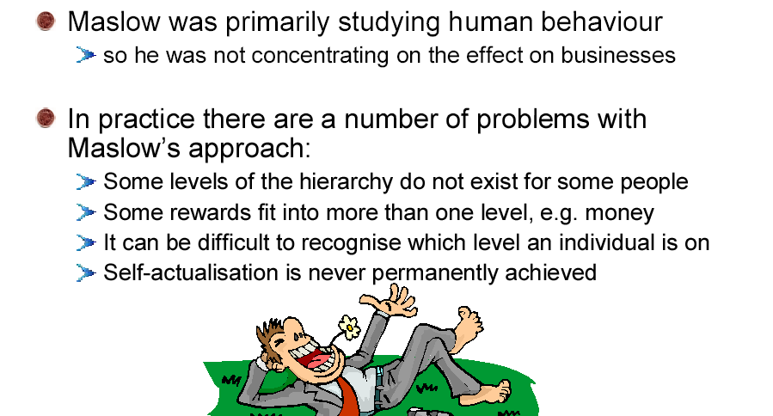
Problems with Maslow’s Theory

Slide 10
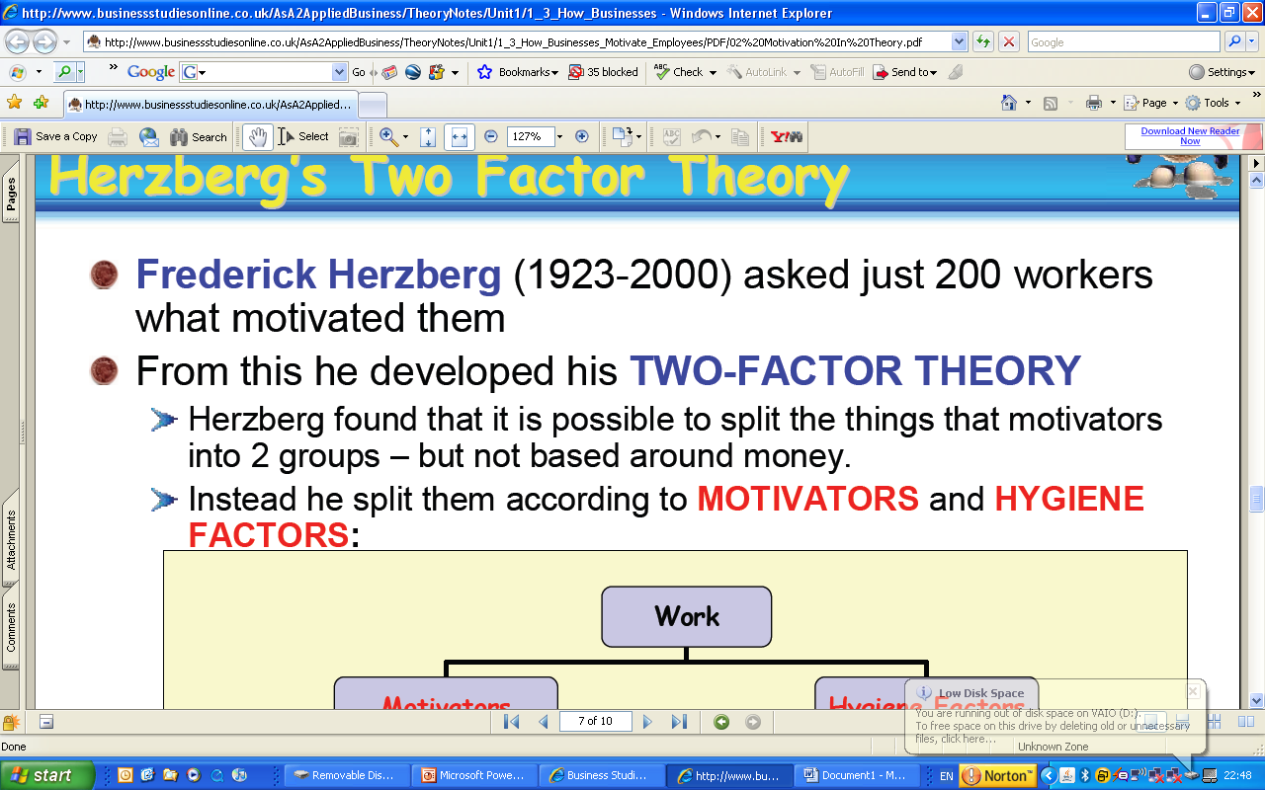
Herzberg’s Two Factor Theory

Slide 11
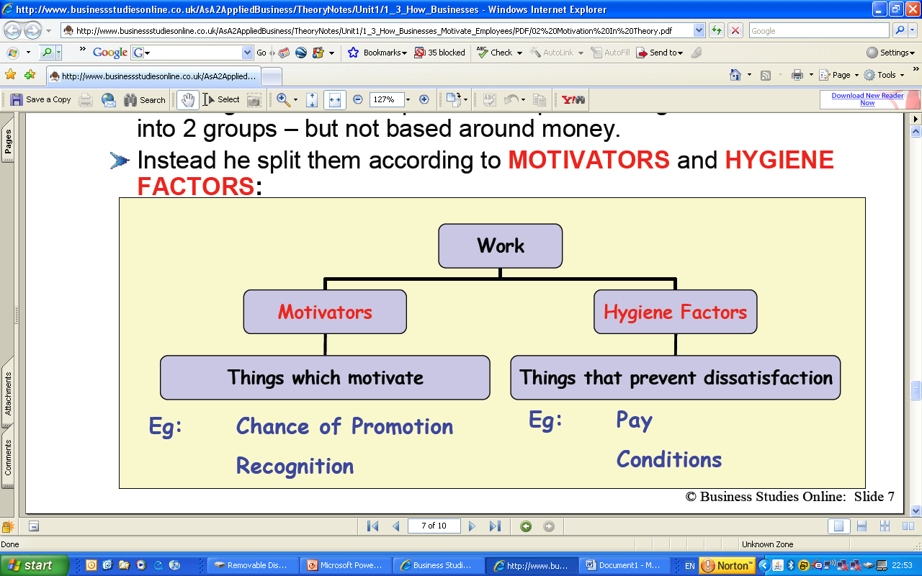
Herzberg Motivators V Hygiene Factors

Slide 12
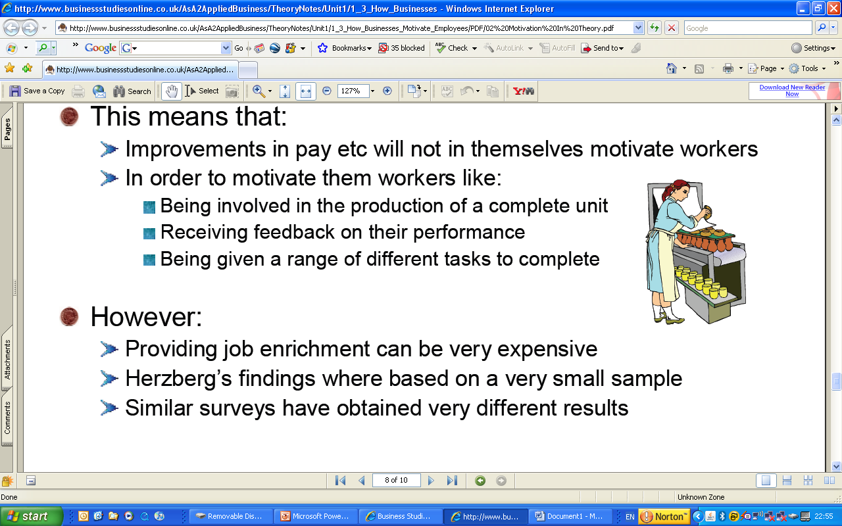
The implications of Herzberg’s Theory

Slide 13
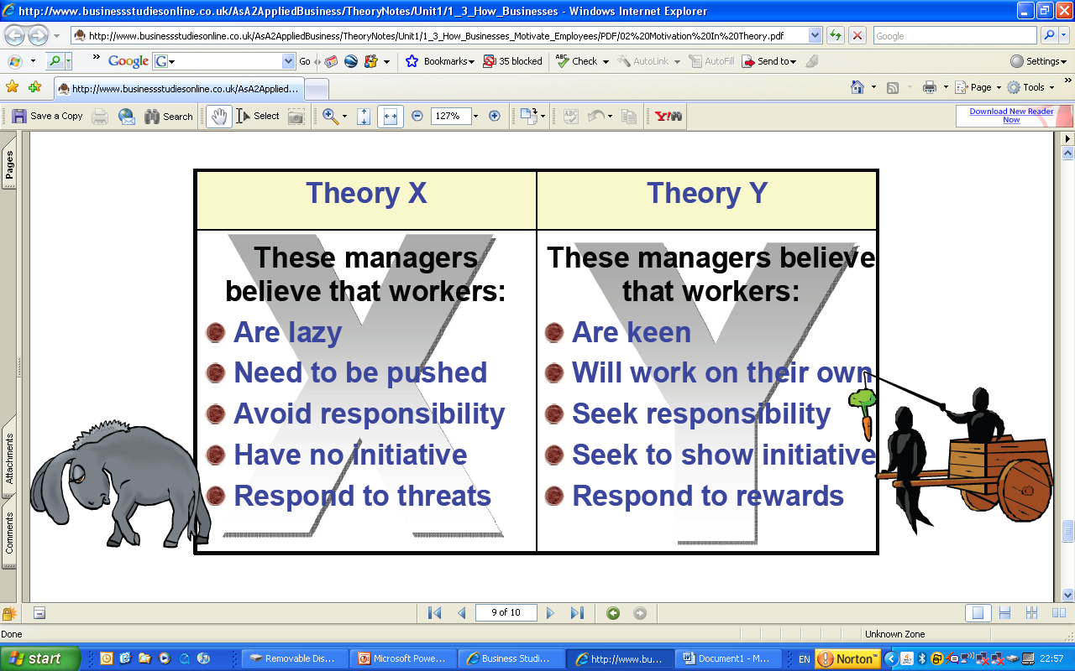
McGregor’s Theory X and Theory Y

Slide 14
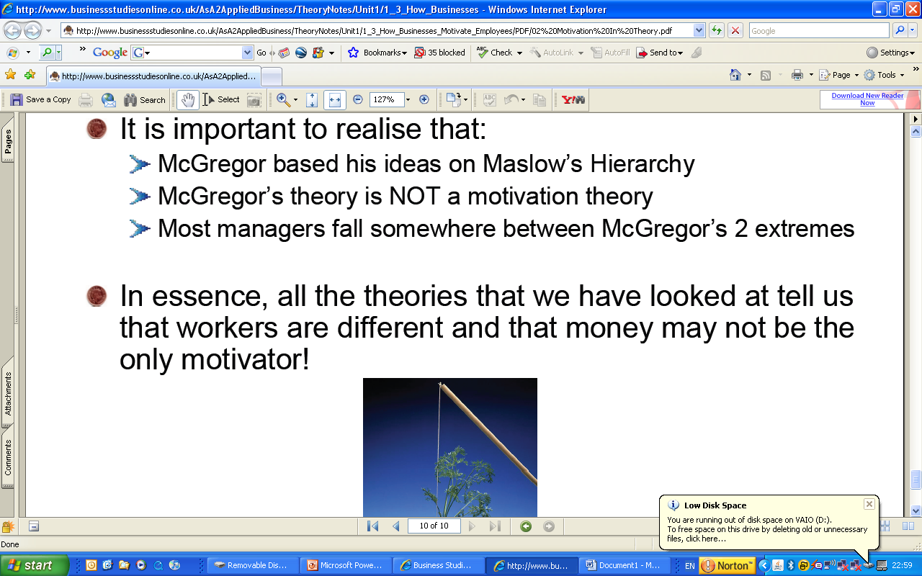
How Useful Is McGregor’s Theory?

